Slide 1

Fnomo
The Moment
Before Action
Every financial action is preceded by hesitation
Users pause before committing capital
This moment carries maximum uncertainty
Most mistakes originate here, not earlier
The highest value moment in finance is not discovery — it's decision

Slide 2
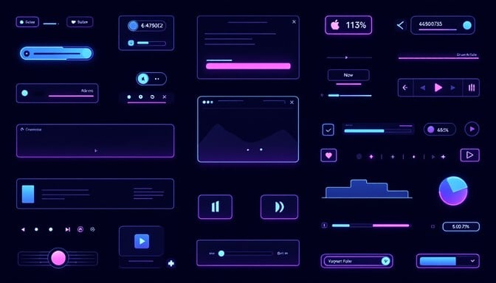
The Market Is Complete
— Except One Layer
Discovery is solved
Content, screeners, signals — abundant and accessible
Comparison is solved
Platforms, aggregators — side-by-side analysis ready
Execution is solved
Brokers, apps — one-click trading everywhere
But validation at decision moment does not exist
The critical gap between intent and action
Users don't need more options — they need clarity before action

Slide 3

Failure Happens at
the Point of Action
Information overload creates confusion
Entry timing is rarely validated
Too much data, too many signals — users drown in noise instead of finding signal
Users act on impulse without structured checks for optimal entry points
Emotional bias overrides logic
Users act without structured decision checks
Fear, greed, FOMO — emotions hijack rational decision-making at the critical moment
No validation layer exists to catch errors before capital is committed
Bad outcomes are caused by poor decisions, not poor data

Slide 4
Fnomo Is a Layer,
Not a Product
Does not replace brokers or platforms
Complements existing infrastructure
Does not compete with discovery tools
Fnomo
Works alongside screeners and research
Sits between comparison and execution
Decision Validation Layer
The missing validation layer
Discovery
Comparison
Fnomo
Execution
Provides decision validation before action
Clarity at the critical moment
Fnomo intercepts intent, not attention

Slide 5
Current Product vs
Intended Behaviour
Current
GTM
Stock screener
Decision-stage entry
→ Exploration tool
→ Validation layer
Users discover and explore — but don't validate decisions
Users validate before acting — clarity at the critical moment
Mismatch reduces effectiveness of acquisition
Fix requires entry-point shift, not rebuild
Same system, different user moment

Slide 6
MVP — Decision Engine
Input
Rules
Stock / trade / idea
Under 10 seconds
No login required
Instant clarity, zero waiting
Frictionless access
No dashboards
Immediate clarity
Output
Zero complexity, pure clarity
Built for the moment
Decision score (clear direction)
Risk level (low / medium / high)
Reasoning (2–3 key signals)
Alternative suggestion
The product is not analysis — it is decision clarity

Slide 7

Execution Is
Behaviour-First
No paid acquisition initially
Focus on real decision environments
Organic growth through value, not advertising spend
Meet users where they actually make choices
No funnel-building at early stage
Prioritize interaction over reach
Focus on behavior, not conversion mechanics
Quality engagement beats vanity metrics
Growth comes from entering decisions, not driving traffic

Slide 8
Where We Enter First
Telegram
Reddit
TradingView
High-frequency, real-time decisions
Validation-driven discussions
Idea-based decision points
Traders making rapid choices in active communities
Users seeking confirmation before committing capital
Technical analysis leading to action moments
All are high-intent environments
We go where decisions are already happening

Slide 9
From Usage to Habit
Decision trigger
occurs
User checks
Fnomo
Confidence
improves
Action
taken
Repeat behavior
builds habit
User faces a
financial choice
Validation in
seconds
Clear direction
reduces doubt
Informed
decision executed
Fnomo becomes
default step
The Habit Loop
Each cycle reinforces trust. Each validation builds dependency.
Fnomo becomes a default step before action

Slide 10
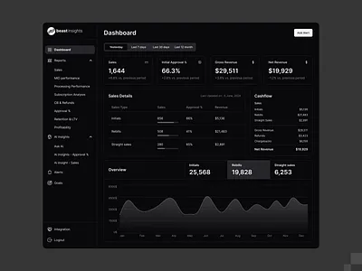
Measuring What Matters
North Star Metric
Pre-action usage rate
Tracks real behavioral adoption. Not dependent on traffic or installs. Indicates trust and habit formation.
20%
30%
40%
Month 1
Month 2
Month 3
If users don't check before acting, the system has no value

Slide 11
Execution Ownership
Enter high-intent communities
Drive conversation-based acquisition
Identify and join where decisions happen
Organic growth through value delivery
Build distribution loops
Establish partnerships post-validation
Create self-reinforcing growth cycles
Scale through strategic alliances
Feed insights back into product
Continuous improvement loop from market to development
Execution is owned end-to-end, not functionally divided

Slide 12
From Concept to
Behaviour in 14 Days
Days 1–3
Days 4–10
Days 10–14
Define decision logic
Enter communities
Introduce Fnomo
Build MVP
Start conversations
Acquire first users
Validate output
Build trust
Track usage behavior
Speed of validation matters more than scale

Slide 13

Fnomo
Execution Is
Already Structured
MVP is clearly defined
GTM is aligned with behavior
Entry channels are identified
Execution system is ready
We don't need to figure this out — we need to start this

